Slide 1
Data Warehouse- test automation
Dariusz Szudrzyński
28.11.2016

Slide 2
AGENDA
Data Warehouse- introduction
Data Warehouse- types of tests
Practical part

Slide 3
Data Warehouse- definition
Data warehouse- introduction
Data Warehouse is central repository of integrated data from one or more disparate sources. They store current and historical data and are used for creating analytical reports for knowledge workers throughout the enterprise.

Slide 4
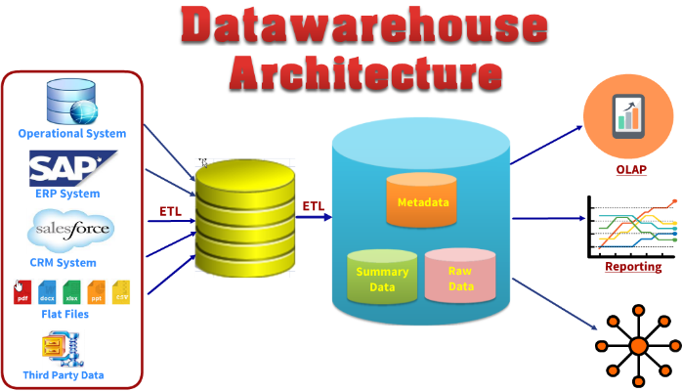
Data Warehouse example
Data warehouse- introduction

Slide 5
Data Warehouse- layers
Data warehouse- introduction
Source
Stage
Cleanse
Core
Mart

Slide 6
Multi-dimensional data model
Data warehouse- introduction
Fact table
In data warehousing, a Fact table consists of the measurements, metrics or facts of a business process. It is located at the center of a star schema or a snowflake schema surrounded by dimension tables. A fact table typically has two types of columns: those that contain facts and those that are a foreign key to dimension tables.
Dimension table
A dimension is a structure that categorizes facts and measures in order to enable users to answer business questions. Commonly used dimensions are people, products, place and time

Slide 7
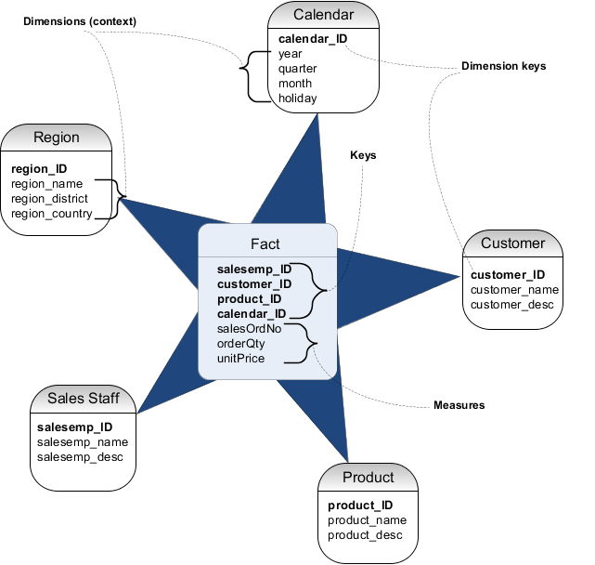
Star schema
Data warehouse- introduction

Slide 8
Data Warehouse- types of tests

Slide 9
Data operations
Data warehouse- testing
Extract
Transform
Load
Filter
Aggregate
Join

Slide 10
What we need for effective testing?
Data warehouse- testing
Test data
Test framework
Code repository
Contionus integration
Bug report

Slide 11
What and how we should test?
Data warehouse- testing
Data flow
Data sets
Data quality
Performance

Slide 12
Practical part

Slide 13
Thank you
Dariusz Szudrzyński
Email: dareknet@gmail.com

